Slide 1
A picture tells…
2022 Primary Mathematics Education Conference – Teacher’s Day
Jennifer Bowden

Slide 2
D2: A picture tells…
Picture books are a springboard for creative and critical teaching where students can make strong mathematical connections between concepts and language. Picture books contain both imagery and dialogue that can ignite curiosity and in which teachers can create purposeful and innovative learning tasks. In this workshop, we will investigate how good quality picture books can develop deep mathematical understandings for our students. In addition, we will look at a range of tasks that utilise the mathematical proficiencies.

Slide 3
What data would you like to see? (Fluency)

Slide 4
Benefits of integrating children’s literature:
Help children learn maths concepts and skills
Provide a meaningful context
Facilitate the development of mathematical language
Assist with problem solving, reasoning and thinking
Provide a richer view of mathematics
Improved attitudes towards mathematics
Engagement!
Engaging with Mathematics through Picture Books (2017)
Tracey Muir, Sharyn Livy, Leicha Bragg, Julie Clark, Jill Wells & Catherine Attard

Slide 5
Framework for selecting books:
Perceived – books that are written to entertain concepts
Explicitly occurring – designed to specifically teach a concept
Embedded – written to entertain but include mathematical ideas
Engaging with Mathematics through Picture Books (2017)
Tracey Muir, Sharyn Livy, Leicha Bragg, Julie Clark, Jill Wells & Catherine Attard

Slide 6
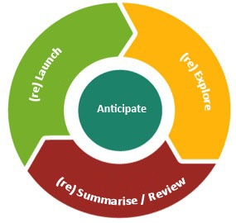
An instructional model
The sequence
Anticipate (student strategies & questions)
Launch (without telling)
Explore (for themselves)
Enabling prompts
Extending prompts
Summarise (drawing on student learning)
…is cyclical and might happen more than
once in a lesson
Notes:
It’s an interactive process

Slide 7
Tips for keeping it as a stimulus
Multiple exposures
Read the important part
Authentic cross curricular connections
Relaunch by coming back to the book
Summarise by completing the book
Use the book for multiple activities

Slide 8
How different are we?
Level 5
Pose questions and collect categorical or numerical data by observation or survey (VCMSP205)
Construct displays, including column graphs, dot plots and tables, appropriate for data type, with and without the use of digital technologies (VCMSP206)
Describe and interpret different data sets in context (VCMSP207)
Level 6
Construct, interpret and compare a range of data displays, including side-by-side column graphs for two categorical variables (VCMSP235)
Interpret secondary data presented in digital media and elsewhere (VCMSP236)
Pose and refine questions to collect categorical or numerical data by observation or survey (VCMSP237)
Level 3
Collect data, organise into categories and create displays using lists, tables, picture graphs and simple column graphs, with and without the use of digital technologies (VCMSP149)
Interpret and compare data displays (VCMSP150)
Level 4
Select and trial methods for data collection, including survey questions and recording sheets (VCMSP178)
Construct suitable data displays, with and without the use of digital technologies, from given or collected data. Include tables, column graphs and picture graphs where one picture can represent many data values (VCMSP179)
Evaluate the effectiveness of different displays in illustrating data features including variability (VCMSP180)
Collect, Construct, Comparing, Categorising

Slide 9
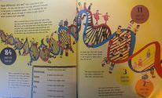
How different are we? (Launch)
Using the information supplied explore and present our global village differences. You may:
Collect data
Construct displays
Compare and categorise the information
Evaluate, is your display useful? Why? Why not?

Slide 10
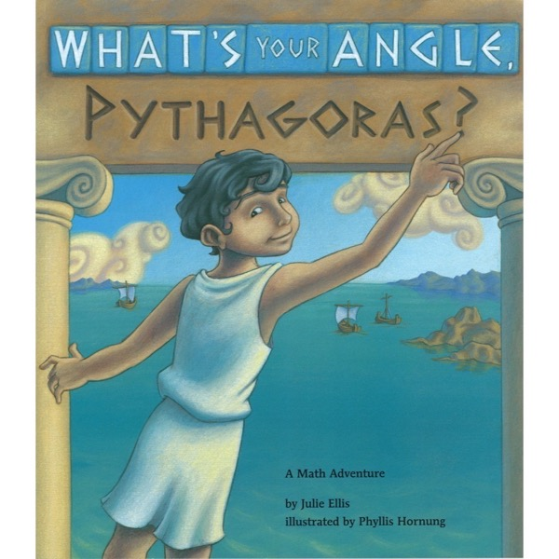
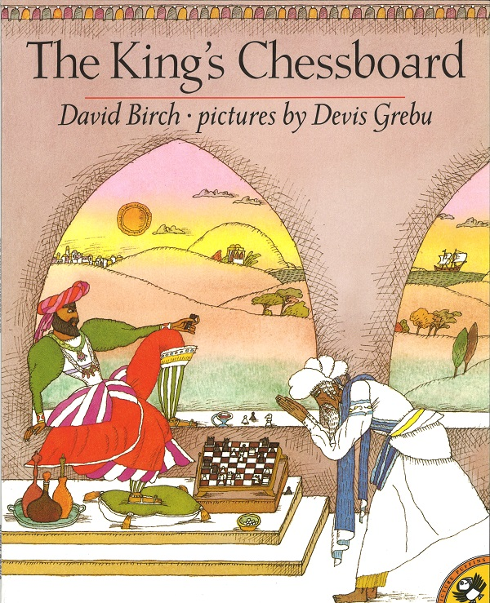
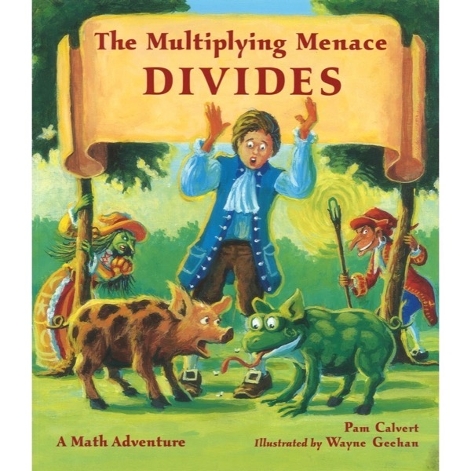
Explicit content

Slide 11
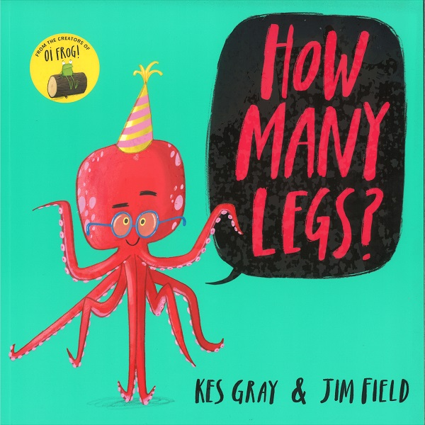
Counting, place value and special numbers

Slide 12
Time and measurement

Slide 13
The classics

Slide 14
Real world applications

Slide 15
Dispositions

Slide 16
Location

Slide 17
Mapping

Slide 18
Chance and data

Slide 19
Shape

Slide 20
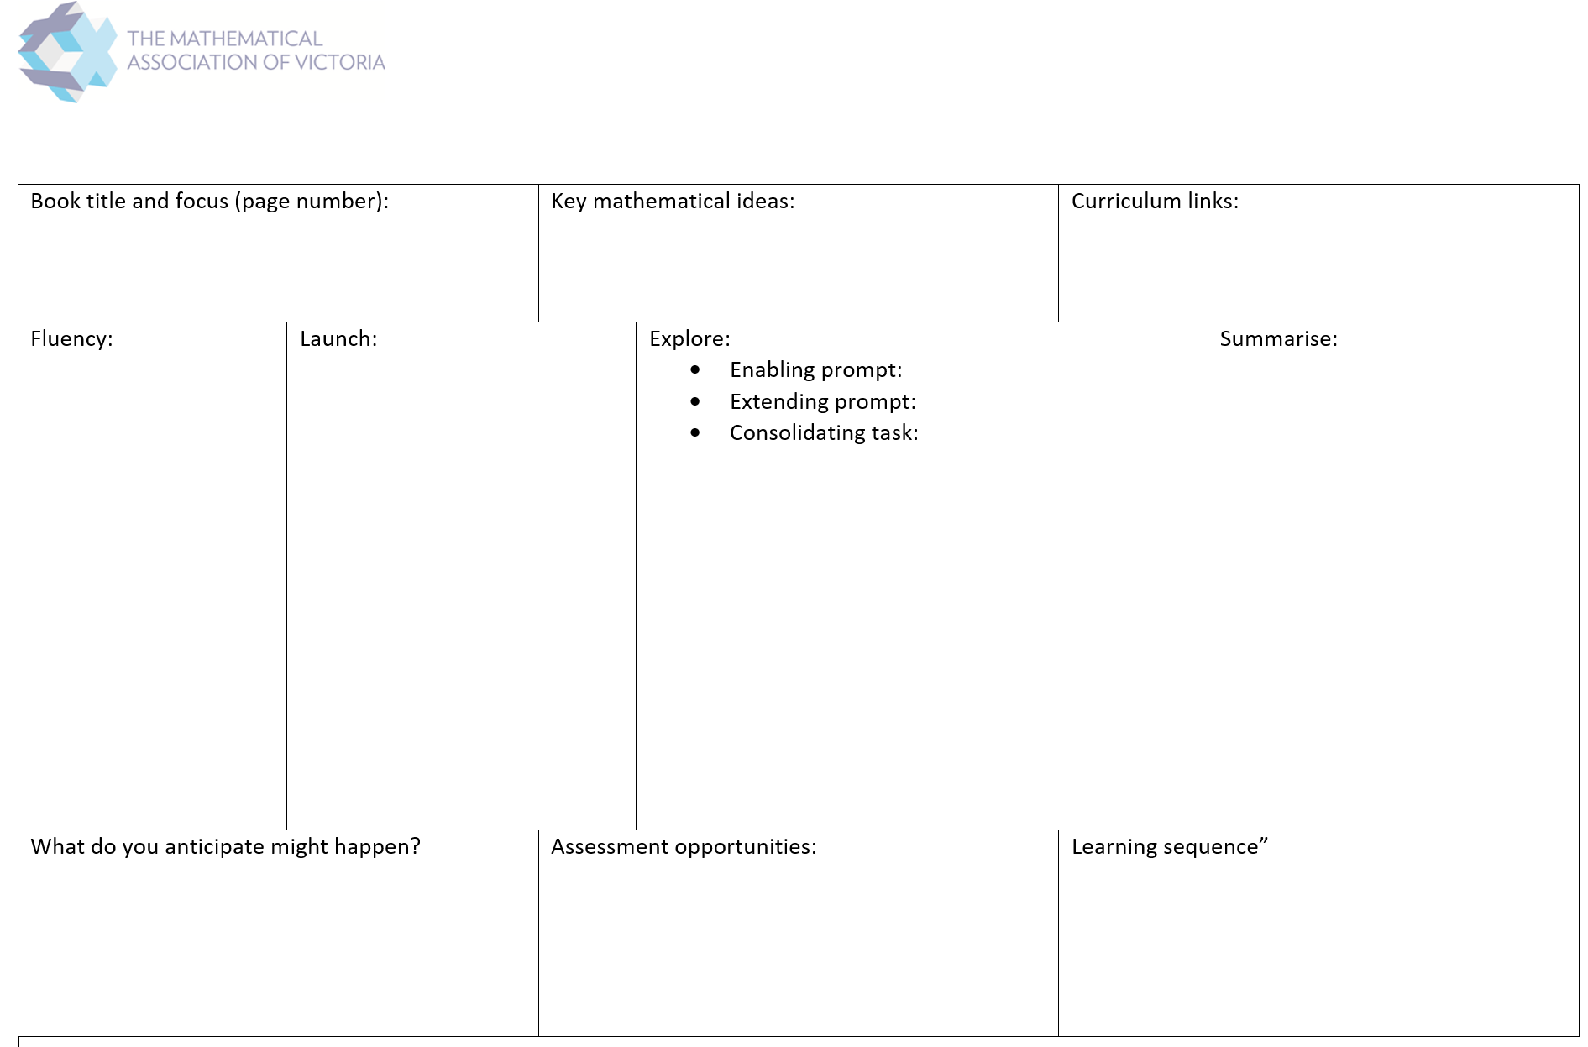
Plan you own task (Explore)

Slide 21
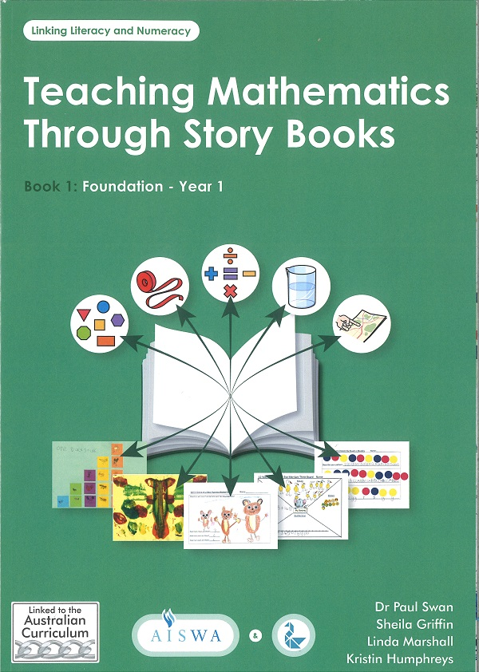
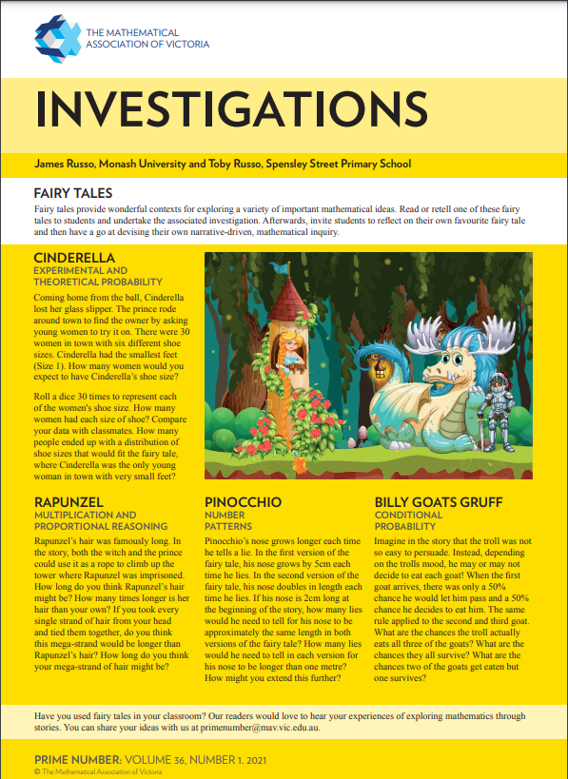
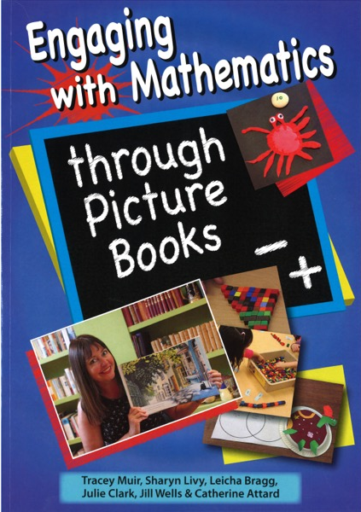
Resources

Slide 22
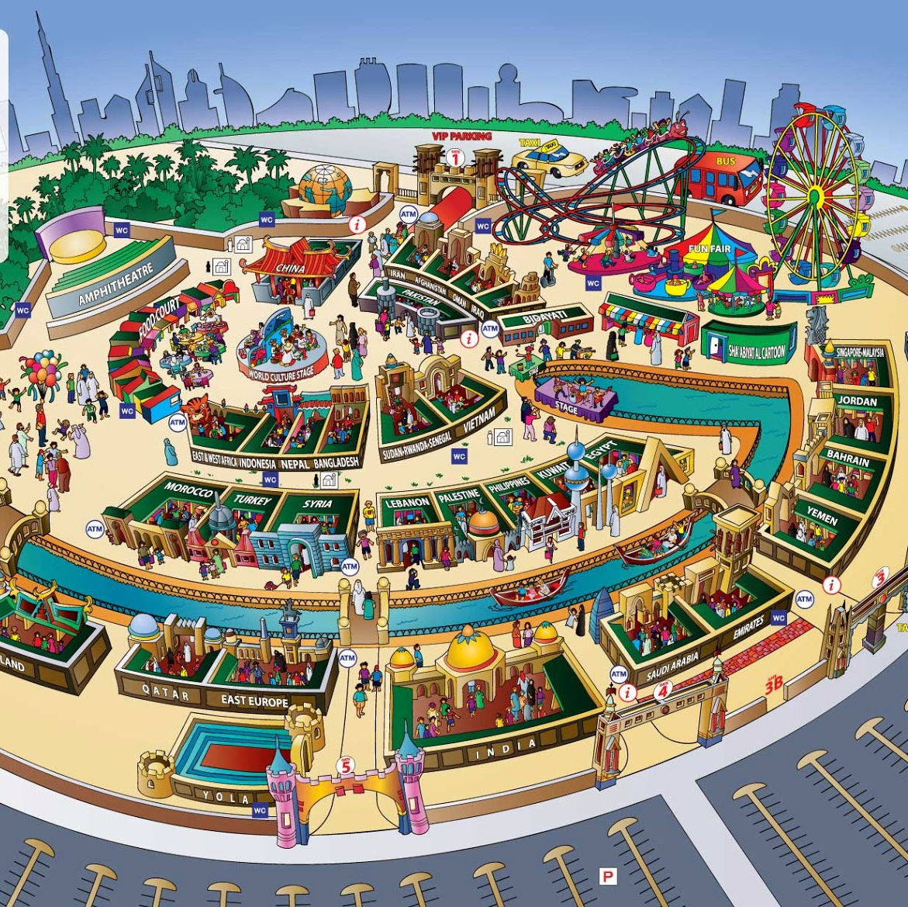
Summarise
What are the big questions? Let’s consider what the world will be like on 2050, there will be roughly 10 billion people in the world. That’s the same as having another Africa or Europe on the planet. What will our global village look like then?

